Slide 1
Lecture 6: Inside the processor options / efficiency
Basic Data Types
Arithmetic and Function Evaluation
Floating Point and Fixed Point Number Systems
Truncation / Rounding
Error Analysis—Elementary Examples

Slide 2
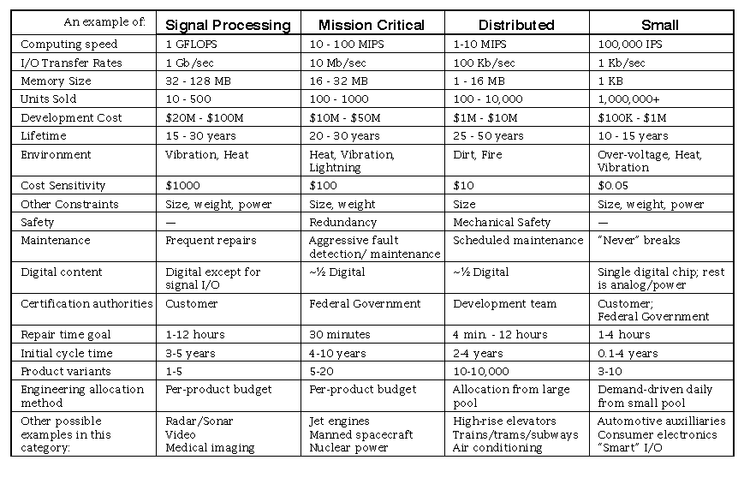
Example systems:
--what data types are needed for each system?
--what features of available data types are especially relevant to embedded systems?

Slide 3
“universal” data types: integer--signed / unsigned (“whole numbers”)
(Character, Boolean)
(type integer is going to be used for counting, looping, addresses,etc., as well as for computing functions of data)
Ex: 11111111 11111110 10000000 01111111
unsigned integer:
2’s complement:
1’s complement:
cout? overflow?
How is overflow detected (2’s c)? 011 + 011 = ?
111 + 111 = ?
011 + 100 = ?
111 + 110 =?
See next slide for details about overflow

Slide 4
OVERFLOW--Examples
cout? overflow?
How is overflow detected (2’s c)? 011 + 011 = ?
111 + 111 = ?
011 + 100 = ?
111 + 110 =?
010 + 001 =?
Overflow:
Method 1: pos+pos->neg OR neg+neg->pos
Method 2: carryout of sign bit >< carryin of sign bit
(check these methods with 111 + 110, 011 + 011

Slide 5
Integer arithmetic
What are the basic functions to include?
What implementation of each function will optimize
  Speed?
  Size?
  Power usage?
  Possible list:
    Conversions analog ←→ digital
    Conversions decimal ←→ binary
    Shifts: left/right; logical/arithmetic; linear/circular
    Addition / subtraction /comparison
    Multiplication
    Division / square root (why put these together?)
    Function approximations (trig, exp, log, e.g.)
    Which are the truly “fundamental” operations?

Slide 6
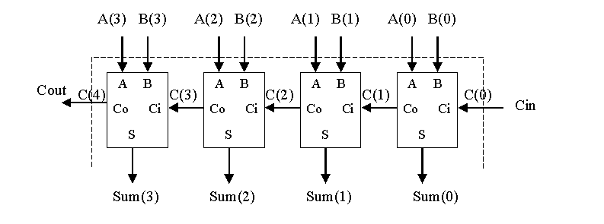
Example: addition (i)
Fundamental operation: Addition / subtraction:
Note: overflow: result can be one bit larger than inputs
What adder designs are available?
Example: O(n) adder for n-bit inputs
Small, slow: ripple carry adder (recall typical FPGA LUT):
Source: http://www.ece.msstate.edu/~reese/EE4743/vhdlcomb/sld027.htm

Slide 7
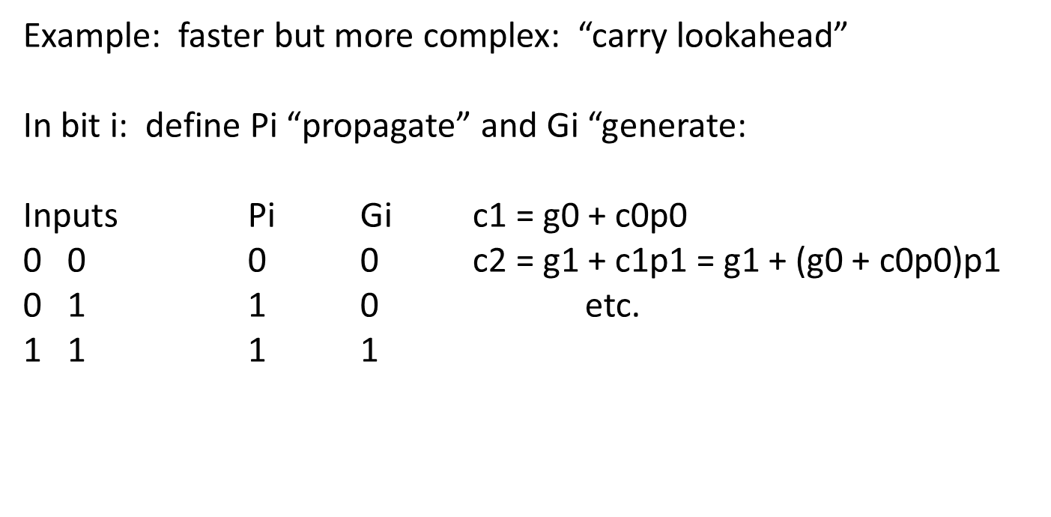
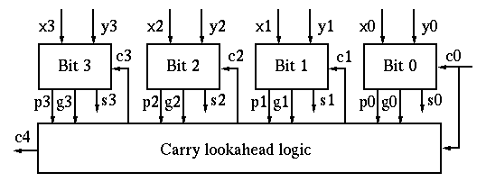
Example: addition (2)
Note: why is it that:
1.in theory we can propagate carries as far as we want to get O(log n) time;
2.in practice we will only propagate the carry a fixed number of bits, e.g., 4.
Source: http://fourier.eng.hmc.edu/e85/lectures/arithmetic_html/node7.html

Slide 8
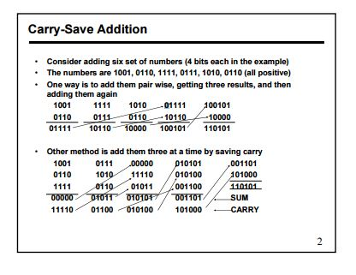
Example: multiplication (i)
Product of 2 n-bit numbers can be stored in 2n bits
Simplest solution: add n times: time O(n²)
Another possible solution: “carry-save” addition: each adder computes a sum and a carry; 3 inputs generate 2 outputs; time O(n)
Inputs: Sum Carry
000 0 0
001 1 0
011 0 1
1 1
Source: http://home.eng.iastate.edu/~zzhang/courses/cpre305_s03/lectures/week06-4pp.pdf

Slide 9
Example: Carry-save adder for four operands
Goal: add X,Y,Z,W
Step 1: add X,Y,Z, get S,C ( 1time unit)
Step 2:add S,C,W, get S’,C’(1 time unit)
Step 3 (last step):
resolve carries
(must be a “true” addition)
x₃ x₂ x₁ x₀
y₃ y₂ y₁ y₀
z₃ z₂ z₁ z₀
w₃ w₂ w₁ w₀
s₃ s₂ s₁ s₀
c₄ c₃ c₂ c₁
w₃ w₂ w₁ w₀
c₄ s₃ s₂ s₁ s₀
c₄ c₃ c₂ c₁
’
’
’
’
’
’
’
’
S₅ S₄ S₃ S₂ S₁ S₀
Source:http://ece.gmu.edu/coursewebpages/ECE/ECE645/S10/viewgraphs/ECE645_lecture6_multiadd.ppt

Slide 10
Multiplication (ii)
compute 15 X 15 in 10-bit 2’s c
Using carry-save arithmetic: 1111 * 1111
Using Booth encoding (15 = 16 – 1):
(1111 * 10000) - 1111
(use digits 1, 0, -1)
Can you estimate time for method a, method b, standard multiplication?

Slide 11
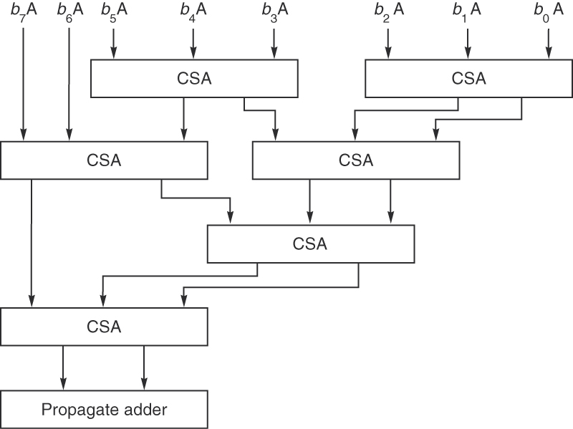
Example: multiplication (iii) —Wallace tree
Figure J.30 Wallace tree multiplier. An example of a multiply tree that computes a product in 0(log n) steps.
Authors: John Hennessy & David Patterson
Copyright © 2011, Elsevier Inc. All rights Reserved.

Slide 12
Example: division (i)
X = Q*D + R, R < D (all positive)
Division, like most “inverse” problems, is more difficult than multiplication
Simplest method: multiple subtractions; dividend in a “register pair”; shift the double register left, subtract D from the left-most register if possible and shift in 1, else shift in 0; note that overflow can occur
Example: compare the result of 6/2 with the result of 18/2
R1, R2: 6/2 R1, R2: 18/2
Initial: 0000, 0110 0001, 0010
Shift R1,R2, compute lsb of quotient 0000, 1100 0010, 0100
Shift R1,R2, compute lsb of quotient 0001, 1000 0100, 1001
Shift R1,R2, compute lsb of quotient 0011, 0000 1001, 0011

Slide 13
Example: division (ii)
Some other methods commonly used for division:
“restoring”; always subtract; if result is negative, add back in
“nonrestoring”: use digits +1, -1 for quotient. If the partial remainder is negative, the quotient digit is -1, and we add the divisor back in on the next step
SRT division: “guess” the quotient digit; use a look-up table to help choose an accurate digit
Series methods, e.g., 1/b = 1/(1 + X) = 1 – X + X² – X³ + …(Maclaurin series)
Use approximations, e.g., Newton’s method for f(X) = 1/ X - b and compute approximation X_{i+1} = X_{i} – f(X_{i})/f’(X_{i}). . This is considered a “fast” method, since it gives two digits per iteration.
Note: square root can be computed by methods similar to division since the “pencil & paper” method to find square roots is based on(X+Y)² = X² + 2XY + Y²
Example: square root of 2731: 5² = 25, so 2731 = (5*10 + Y)² = 2500 + 2*50Y + Y²
(etc.)

Slide 14
Table look-up
Example: multiplication of 3-bit integers:
0 1 2 3 4 5 6 7
0 0 0 0 0 0 0 0 0
1 1 2 3 4 5 6 7
2 4 6 8 10 12 14
3 9 12 15 18 21
4 16 20 24 28
5 25 30 35
6 36 42
7 49
Must not forget diagonal entries (Intel)!

Slide 15
More complex functions: e^{x}, log x, sin x, cos x, ….
1. Can use series expansion (e.g., Taylor or Maclaurin series)
2. can use a fixed set of polynomials (e.g., Chebyshev polynomials) to approximate the desired function
3. Can store a table and do table look-up
4. Can use cubic polynomials
Example: (Hauser and Purdy, Embedded Systems Programming, 2003): use a genetic algorithm to find the coefficients of approximating cubic polynomials (“splines”)

Slide 16
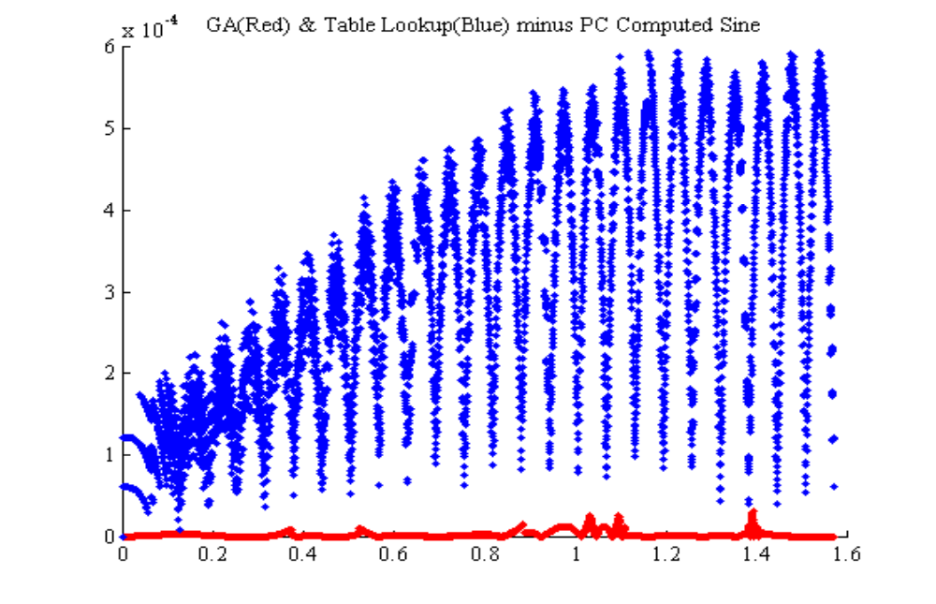
Sine Function--Comparison of Results (Hauser & Purdy 2003)
Method Error (Worst Case) Taylor (float) 4 x 10⁻⁶
Taylor (fixed) .25
Chebyshev (float) 7 x 10⁻⁶
Chebyshev (fixed) 5 x 10⁻³
Table Lookup (fixed) 6 x 10⁻⁴
Genetic Algorithm 3.5 x 10⁻⁵

Slide 17
Example: DSP (digital signal processing)
Typically data input / output streams must be processed in “real time” (e.g., video signals or heart rate monitors)
So “locality” of operations is important, data must be processed as it arrives
Pipelined algorithms are very useful for this type of system

Slide 18
Summary: when can overflow occur?
How do we deal with it?
Are there other “error” cases we need to look at?
Suppose we store each integer in n bits (unsigned or 2’s complement). What complications can occur for:
Addition:
Subtraction:
Multiplication:
Division:

Slide 19
Other Number Systems:
Fixed Point & Floating Point Numbers

Slide 20
Floating point format
Sign (1 bit) exponent (“magnitude”) mantissa
(“significant digits”/significand)
Ex: IEEE “7-54” format: exponent is 8 bits, mantissa is 23 bits (single precision)
Examples:
a.1 01111101 00101100000000000000000
is interpreted as:
((−1)x1) × (1 + 1/8 + 1/32 + 1/64) × 2^(125–127) = -1.34375× 2^(−2)
= ((−1)x1) × (1 + 0.171875) × 2^(125–127) = -1.171875× 2^(−2) = -0.29296875
b. 0 10010010 10110001010000000001000
Is interpreted as:
((−1)x0) × (1 + ½ + 1/8 + 1/16 + 1/256 + 1/1024 + 1/1048576) × 2^(146–127)
= ((−1)x0) × (1 + 0.6923828125 + 1/1048576) × 2^(146–127)
= ((−1)x0) x (1.6923828125 + 1/1048576) x 549755813888
(ref: http://en.wikipedia.org/wiki/IEEE_floating_point )
  Floating point numbers are typically normalized, i.e., they are stored without leading zeros in the mantissa (and with the implied “1.0” omitted)

Slide 21
Floating Pt Numbers—Some Terms/Issues
Numbers not equally spaced like integers—distance between two numbers varies (with magnitude)
0 can be +0 or -0
Underflow can occur, i.e., a number becomes so small that its significand is 0—can use “subnormal numbers”—many processors do this for you
“infinity” can be represented and used in calculations, for example:
(+∞) + (+7) = (+∞)
(+∞) × (−2) = (−∞)
(+∞) × 0 = NaN – there is no meaningful thing to do
Some operations return NaN, “Not a Number”, e.g., 0/0, ∞×0, sqrt(−1); this value can be propagated through subsequent computations, e.g.,
7 + NaN = NaN
rounding must be considered; floating point units typically have extra “guard bits” to enable reasonable rounding rules
Exceptions are typically recorded in “sticky bits”, which are special status flags, e.g., when NaN results; sticky bits are NOT reset by the next operation, they must be reset explicitly

Slide 22
Summary: ALU (floating point):
If X,Y are floating point numbers (IEEE standard format),
X = (sign bit) [1.x₁x₂x₃…..] * 2e
Y = (sign bit) [1.y₁y₂y₃.....] * 2^{f}
addition / subtraction: shift so exponents are the same, add significant digits, shift result to normalize
Multiplication: multiply (signed) significant digits, add exponents, shift result to normalize
Division: divide (signed) significant digits, find difference of exponents, shift result to normalize
Complex, slow, many possibilities for approximation errors

Slide 23
Operations on (normalized) floating point numbers:
Ex: -1.01 x 2⁴, +1.011 x 2⁻⁷
What ALU operations are required?
Operation Preprocess Operate Postprocess
Add / subtract
Multiply
Divide
Note that both “overflow” and “underflow” can occur for floating point numbers

Slide 24
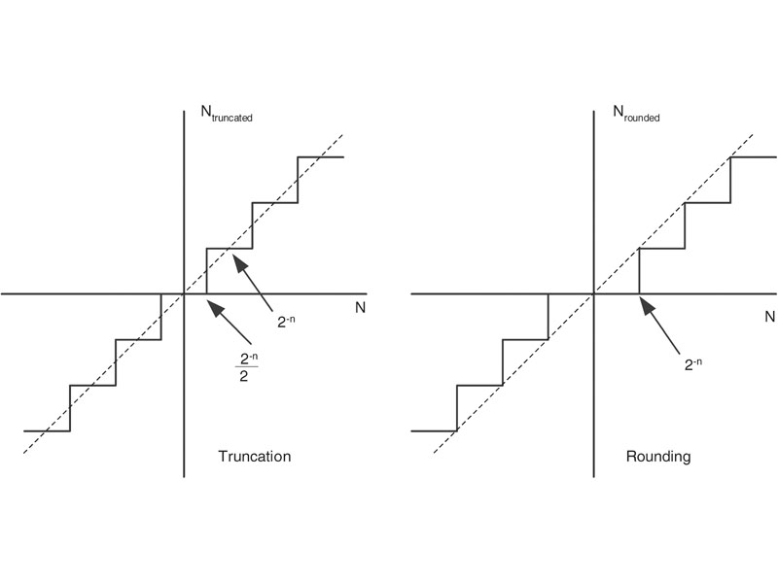
fig_01_09
Floating point errors: three sources
Measurement error (input);
Conversion error (input / output)
Overflow or underflow
Most base 10 fractions cannot be represented exactly in binary:
Example: how to represent 2.x in 4 bits, with 2 bits of resolution?
Choices: 2.0, 2.25, 2.5, 2.75, 3.0
2.1 → 2.0 or 2.25
2.2 → 2.0 or 2.25
2.3 → 2.0 or 2.25 or 2.5
Q: which of these errors can occur for “fixed point”, which we describe below?
Ref: Peckol
fig_01_09
r
rounding
truncation
truncation
rounding
down
Error range for n bits of resolution:
Truncation: -2^{-n} < E_{truncation} < 0
Rounding: - ½ 2^{-n} < E_{rounding} < ½ 2^{-n}
Computation: which is easier to compute?
rounding
up

Slide 25
fig_01_09
Error propagation in arithmetic:
Examples:
Consider two numbers whose true values are N₁ and N₂
and whose values in the computing system are N_{1E} and N_{2E}
Addition: errors add: N_{1E} = N₁ + E₁
N_{2E} = N₂ + E₂
N_{1E} + N_{2E} = (N₁ + E₁) + (N₂ + E₂)
= N₁ + N₂ + E₁ + E₂
Multiplication: error :
N_{1E} * N_{2E} = (N₁ + E₁) * (N₁ + E₂)
= (N₁N₂) + (N₂ * E₁ + N₁ * E₂) + (E₁ * E₂)
term 1 term 2
Note that if term 2 is neglected then error depends on size of N₁ and N₂

Slide 26
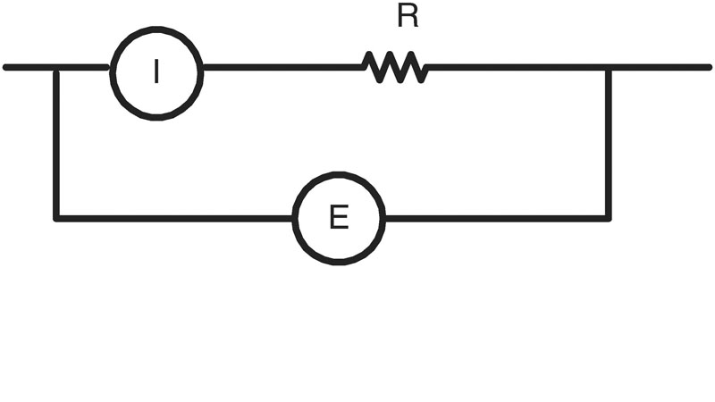
fig_01_10
Another example (pp. 11-12 of Peckol): measuring power dissipated in resistor R in the following circuit:
Suppose E = 100 VDC +/- 1%, I = 10A +/- 1%, R = 10 ohms +/- 1%.
3 methods of calculating power dissipated, neglecting lower order error terms:
a. E1 = (100V +/- 1%) * (10A +/- 1%) = 998.9 → 1001.1
b. I²R = (10A +/- 1%) * (10A +/- 1%) * (10 ohms +/- 1%) = 997 → 1003
c. E3 = (100 V +/- 1%)*(100 V +/- 1%) / (10 ohms +/- 1%) = 908.9 → 1111.3
Which should we use?
“optimistic”: a
“middle-of-the-road”: average of a,b,c
“safest”: c
fig_01_10

Slide 27
Q: Why use floating point numbers?
A: floating point numbers allow for operands to vary widely in magnitude.
Q: will there be large variations in magnitude in a typical embedded system application?
A: consider the example systems we have listed. When will there be large variations in the magnitudes of the numbers that appear in calculations in these systems?

Slide 28
Example: inattention to arithmetic errors can be fatal
“On February 25, 1991 a Patriot missile battery failed to intercept an incoming Scud missile aimed at an army barracks in Dhahran, Saudi Arabia. When the Scud missile hit the barracks 28 soldiers lost their lives and 99 were wounded. This was the largest single loss of life among coalition forces in that war.
The General Accounting Office (GAO) was called upon to investigate the incident. Their report pointed to round-off error being a key causative factor.”
Ref: http://faculty.kutztown.edu/rieksts/385/topics/commensurability/patriot.html

Slide 29
Arithmetic: Fixed Point
Most embedded systems deal with physical input and output (medical data, mechanical quantities, temperature, concentration of a material in a mixture, etc.)
Data is typically analog and so has fractional part and a measured precision (or error range). Typically analog data will be converted to digital form for processing and then digital results are converted back to analog form.
So we can employ a third number representation, fixed point.
Fixed point representation is convenient and efficient if the ranges for data / results / errors are easily represented in this form. It is well-suited to many embedded systems and also to FPGA implementation.
(Q: give some examples of systems requiring floating pt and some examples of systems which can use fixed pt)

Slide 30
fig_01_09
Numeric data—fixed pt: U(a,b)-unsigned; A(a,b)-signed
Range is always limited. For fixed point representation, number of digits of resolution is size of fractional part.
Alternate notations: Qf, f = #fractional bits; Qmf-# integer & fractional bits
Example: in 4 numeric bits (unsigned numbers):
Number of bits in fraction range
0 (integer) U (4,0) 0-15
1: xxx.x U(3,1) 0-7.5
(fractions 0, ½)
2: xx.xx U(2,2) 0-3.75
(fractions, 0, ¼, ½, ¾)
3: x.xxx U(1,3) 0-1.875
(fractions, 0, 1/8, ¼, 3/8, ½, 5/8, ¾, 7/8
Note: fixed pt numbers work well with 2’s c if we add a sign bit
(see next slide).

Slide 31
fig_01_09
Signed fixed pt numbers: 2’s c, 1st bit is the sign
Example: in 4 bits , 1st bit = sign bit
(where x is the additive inverse of y if x – y = 0)
 |  | # FRACTION BITS
BITS | ADDITIVE INVERSE | 0 | 1 | 2 | 3
0000 | 0000 | 0.0 | 0.0 | 0.0 | 0.0
0001 | 1111 | 1.0 | 0.5 | 0.25 | 0.125
0010 | 1110 | 2.0 | 1.0 | 0.5 | 0.25
0011 | 1101 | 3.0 | 1.5 | 0.75 | 0.375
0100 | 1100 | 4.0 | 2.0 | 1.0 | 0.5
0101 | 1011 | 5.0 | 2.5 | 1.25 | 0.625
0110 | 1010 | 6.0 | 3.0 | 1.5 | 0.75
0111 | 1001 | 7.0 | 3.5 | 1.75 | 0.875
1000 | 1000 | -8.0 | ---- | ---- | ----
1001 | 0111 | -7.0 | -3.5 | -1.75 | -0.875
1010 | 0110 | -6.0 | -3.0 | -1.5 | -0.75
1011 | 0101 | -5.0 | -2.5 | -1.25 | -0.625
1100 | 0100 | -4.0 | -2.0 | -1.0 | -0.5
1101 | 0011 | -3.0 | -1.5 | -0.75 | -0.375
1110 | 0010 | -2.0 | -1.0 | -0.5 | -0.25
1111 | 0001 | -1.0 | -0.5 | -0.25 | -0.125

Slide 32
Exercises-fixed pt and floating pt
4. What is the binary representation of the following two decimal numbers in U(8, 8)? In U(4, 4)?
^{a. 12.25 b. 16.125}
5. What is the smallest nonzero number we can represent with the U(7, 8) format? In A(7,8)?
6. What is the largest number we can represent with the U(7, 8) format? In A (7,8)?
7. Accuracy is the magnitude of the maximum diﬀerence between a real value and its representation.
The resolution is the smallest non-zero magnitude representable.
What is the accuracy of an U(7,8) number format? What is its resolution? What is the smallest
number one can represent in such a format? What is the largest number?
8. Give the representations for a. -1 in A(7,8); b. -1 in A(3,4)
^{9. What is 0 in A(7,8)?}
10. Suppose your system is measuring two quantities, X, and Y. The magnitude of X is <= 100, and it can be measured to an accuracy of 10⁻². X can be positive or negative. Y is positive, and its magnitude is <= 10. Y can also measured to an accuracy of 10-2. Your system computes X*Y. What fixed point representation A(m,n) should you use for input? For output?
11. Show how to code as a binary [floating point] number: a. -1.0; b. 0.5; c. 1.5; d. -1.5
^{12.} What floating point number is represented by 1 | 1000 0010 | 111 1000 0000 0000 0000 0000
^{13.} Why do we need and how do we represent +oo, -oo, and NaN?
14. What is a denormalized number?
15. What number is represented by 0 | 00000000 | 00100000000000000000000
16. What is “overflow” for floating point numbers? Give an example.
17. What is “underflow” for floating point numbers? Give an example.

